Slide 1
PREDICTION CHALLENGE – Titanic Data Set Example

Slide 2
The Titanic Dataset
The Titanic Tragedy
Some People Survived and Some Didn’t
This Dataset contains some relevant Information
Predict using variables WHO SURVIVED??
Variables Include:
Pclass
Name
Sex
Age
Fare

Slide 3
How to Go About this Prediction Challenge?
First study the Data, How?? USE SUMMARY
Then See if there is any correlation between variables
Then use the information you gained to create model using rpart
Then CROSS VALIDATION
Then PREDICT on testing dataset

Slide 4
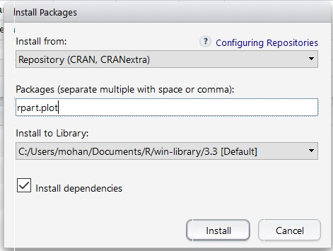
Importing rpart
library(rpart) – to start using rpart R library
library(rpart.plot) – to plot trees generated by rpart.
Make sure rpart.plot is installed (Tools->Install Packages)
Have a look at http://data101.cs.rutgers.edu/laboratory/pages/rpart section of data101 site

Slide 5
Modeling on Titanic data without Control Parameters
library(rpart)
library(rpart.plot)
tree <- rpart(Survived ~ Pclass + Sex + Age + SibSp + Parch + Fare + Embarked, data = train)
tree – This shows the prediction tree in text format
rpart.plot(tree)
Export this plot as a pdf and zoom in.
Have a look at http://data101.cs.rutgers.edu/laboratory/pages/rpart section of data101 site
Notes:
predict <- rpart(GRADE ~ . , data = M2017_train) “.” -> rest of the columns

Slide 6
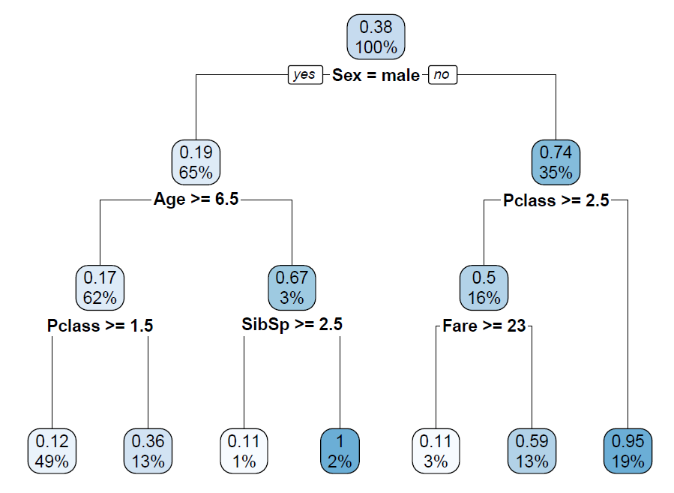
Plot generated by rpart.plot

Slide 7
Titanic Model with Control Parameters
Decision tree may be overfitting – too many levels
tree <- rpart(Survived ~ Pclass + Sex + Age + SibSp + Parch + Fare + Embarked, control = rpart.control(minsplit = 200), , data = train)
Minimum number of observations that must exist in a node for a split to be attempted is 200.
Have a look at http://data101.cs.rutgers.edu/laboratory/pages/rpart section of data101 site

Slide 8
Changing Control Parameters
tree <- rpart(Survived ~ Pclass + Sex + Age + SibSp + Parch + Fare + Embarked, control = rpart.control(minbucket = 100) , data = train)
Minimum number of observations in any terminal leaf node is 100
Have a look at http://data101.cs.rutgers.edu/laboratory/pages/rpart section of data101 site

Slide 9
MODEL SELECTION
After we have created multiple models, how do we select the Model??
Using Cross Validation
Example:
Model1 : tree <- rpart(Survived ~ Sex + Age, control = rpart.control(minbucket = 100) , data = train)
Model 2: tree <- rpart(Survived ~ Pclass + Sex + Age, control = rpart.control(minbucket = 100) , data = train)
Model 3: tree <- rpart(Survived ~ Pclass + Sex + Age + SibSp + Parch + Fare + Embarked, control = rpart.control(minbucket = 100) , data = train)
Use Cross Validation to see which gives you the least error, implementation on next slide
SELECT the Model with the SMALLEST Cross Validation ERROR

Slide 10
After Training your model, CROSS Validation
Code is available at github
install.packages("devtools")
devtools::install_github("devanshagr/CrossValidation")
CrossValidation::cross_validate(DataFrame, RpartOutput, No. of Cross Validations, Split Ratio of Training to Testing Data)
CrossValidation::cross_validate(train, tree, 2, 0.8)
Gives accuracy scores for 2 iterations.

Slide 11
Then Prediction for Kaggle Submission
prediction <- predict(tree, newdata=test, data=“class”)
Once we have the rpart tree, we can use it to predict values on a dataset with above command. <DATASET> should be replaced by a data frame.
You add this prediction Column to the ID’s column and submit this file to kaggle, as shown in last recitation.
In Titanic example, this will print out the predicted Survived column.

Slide 12
THANK YOU

